Slide 1


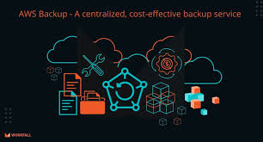
SAVEETHA SCHOOL OF ENGINEERING
SAVEETHA INSTITUTE OF MEDICAL AND TECHNICAL SCIENCES
COURSE CODE:
CSA1590 CLOUD COMPUTING FOR BIG DATA ANLYTICS FOR VIRTUAL CLUSTERS
TOPIC:
Project on Designing and Implementing a Secure VPN Solution on AWS Cloud for a Distributed Workforce
FACULTY NAME:Dr.Gnana Soundari
By,
NAME :M.PRASANTH
REG.NO:192211249

Slide 2
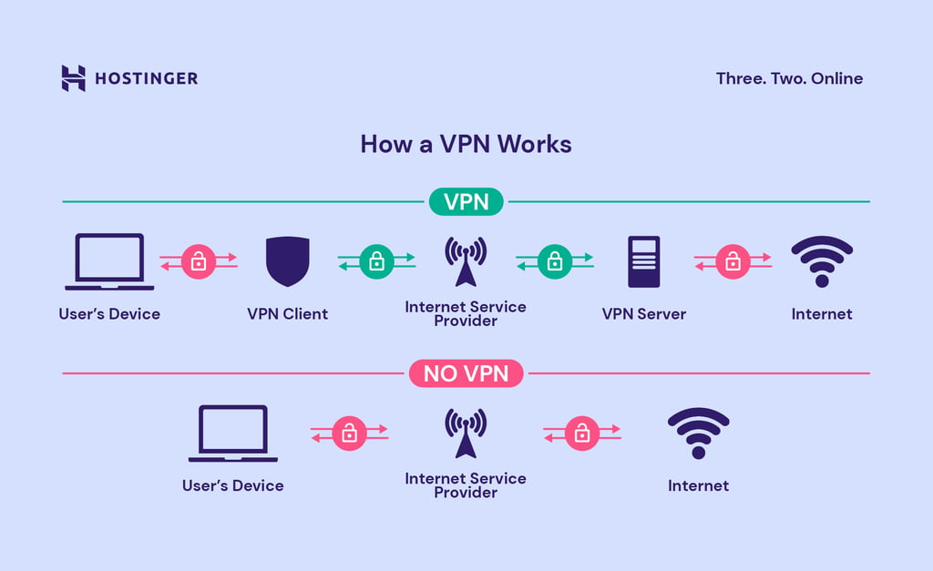
Introduction to Secure VPN Solutions
A Virtual Private Network (VPN) provides a secure connection between users and the cloud.
A secure VPN is essential for protecting sensitive data as a distributed workforce accesses resources.
This presentation outlines the design and implementation of a VPN solution on AWS Cloud.
1
Notes:
Image source: https://www.hostinger.in/tutorials/what-is-vpn

Slide 3
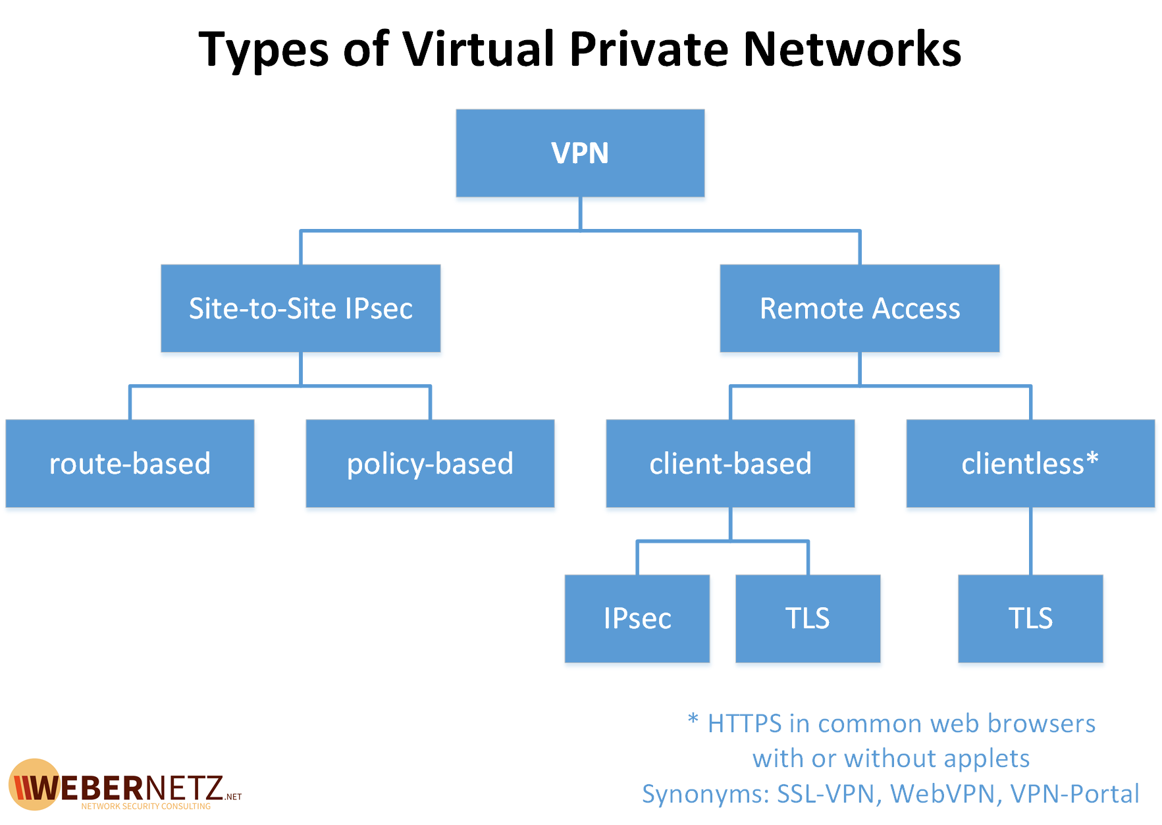
Understanding VPN Types
There are several types of VPNs, including Site-to-Site and Remote Access VPNs.
Each type serves different use cases depending on the organization's needs and workforce distribution.
Understanding these types helps in selecting the right solution for your specific environment.
2
Notes:
Image source: https://weberblog.net/types-of-vpn/

Slide 4
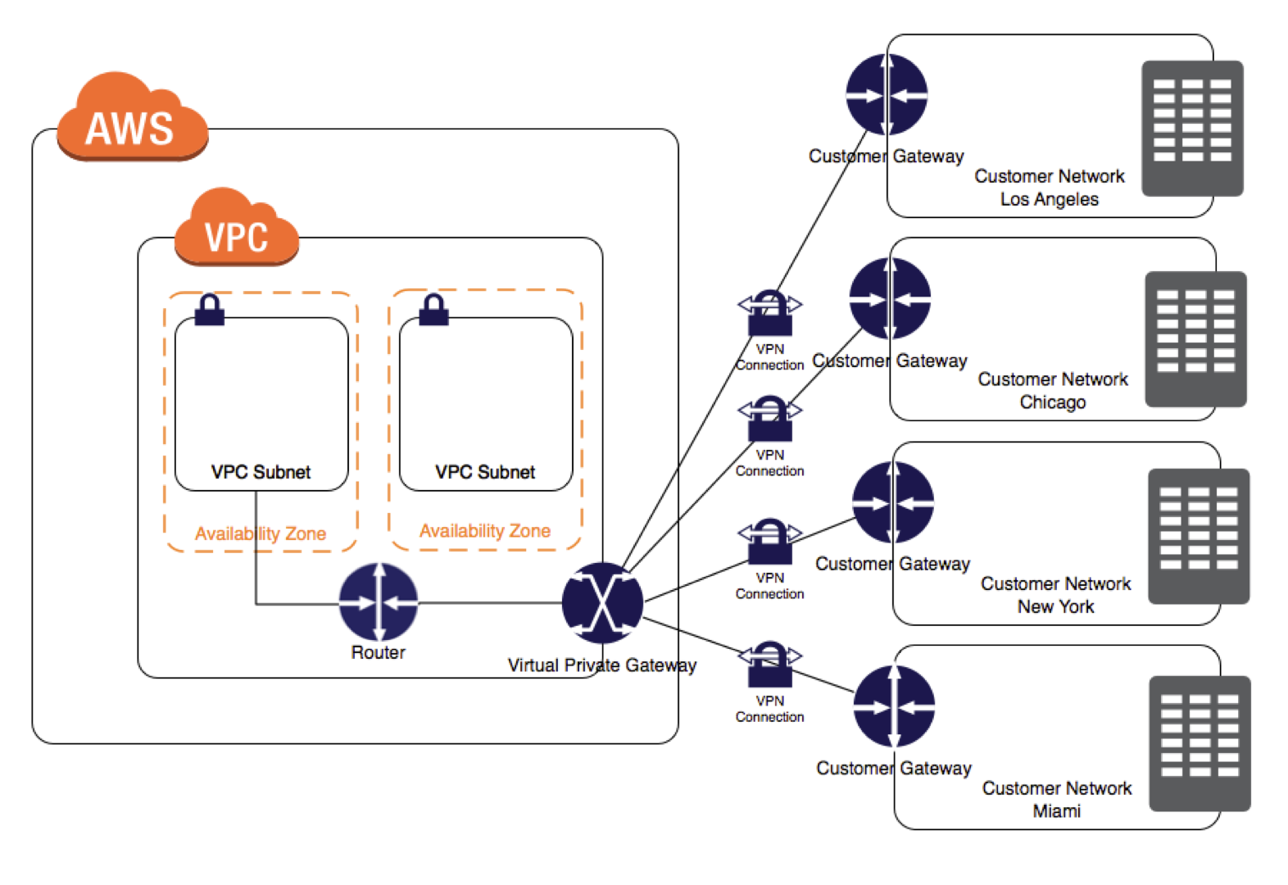
AWS VPN Services Overview
AWS offers multiple VPN services, including AWS Site-to-Site VPN and AWS Client VPN.
These services enable secure connections from on-premises networks and individual users to AWS resources.
Leveraging AWS's robust infrastructure enhances security and scalability for remote access solutions.
3
Notes:
Image source: https://jayendrapatil.com/aws-vpc-vpn-cloudhub/

Slide 5
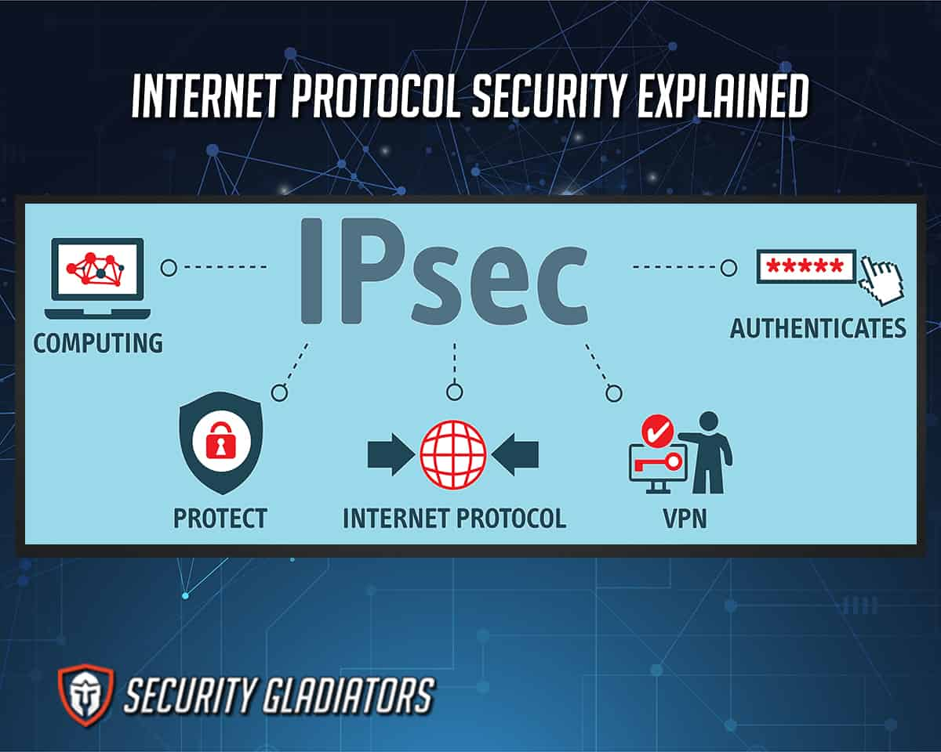
Key Security Considerations
Securing VPN connections involves encryption protocols such as IPsec and OpenVPN.
Regular security assessments and compliance checks are crucial to maintaining a secure environment.
Implementing multi-factor authentication adds an extra layer of security for remote users.
4
Notes:
Image source: https://securitygladiators.com/security/ipsec/

Slide 6
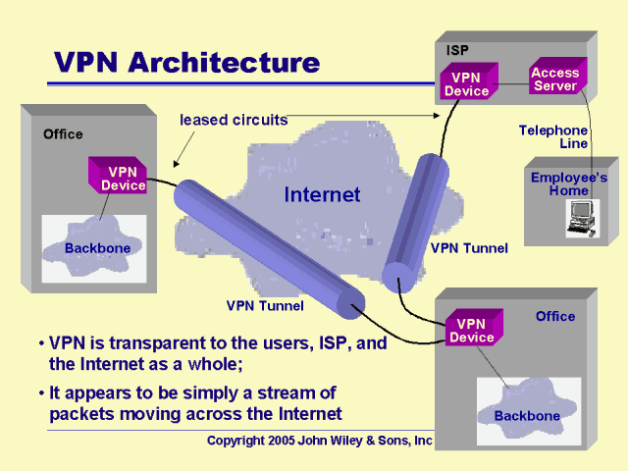
Designing the VPN Architecture
A well-architected VPN solution should consider high availability and redundancy.
The architecture should incorporate AWS services like Amazon VPC, Transit Gateway, and Route 53.
Proper design ensures optimal performance and security for a distributed workforce.
5
Notes:
Image source: https://home.ubalt.edu/abento/650/wan/sld034.htm

Slide 7
Configuring AWS Site-to-Site VPN
AWS Site-to-Site VPN connects your on-premises network securely to your AWS VPC.
Configuration involves setting up a Virtual Private Gateway and customer gateway on AWS.
Routing settings need to be defined to enable traffic flow between networks seamlessly.
6
Notes:
Image source: https://jayendrapatil.com/aws-vpc-vpn-cloudhub/

Slide 8
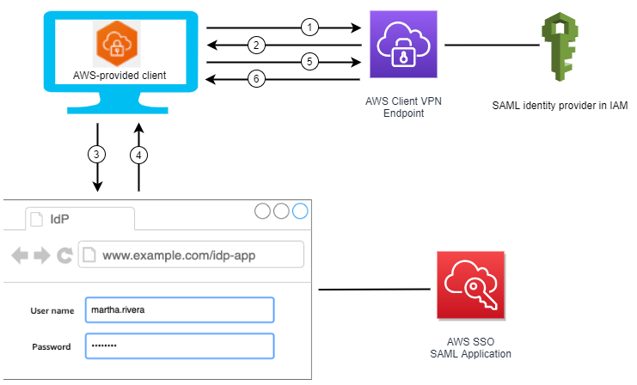
Setting Up AWS Client VPN
AWS Client VPN allows individual users to connect securely to AWS resources from anywhere.
Configuration includes creating a Client VPN endpoint and associating it with a VPC.
User authentication can be configured through Active Directory or SAML-based identity providers.
7
Notes:
Image source: https://noise.getoto.net/2021/08/30/authenticate-aws-client-vpn-users-with-aws-single-sign-on/

Slide 9
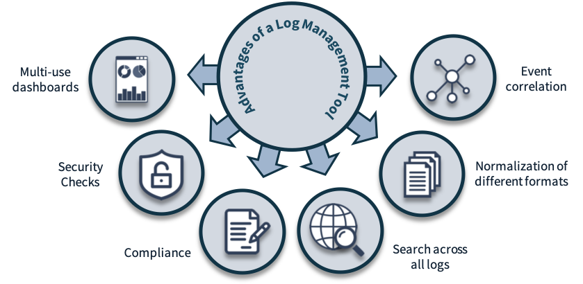
Monitoring and Logging
Monitoring VPN connections is essential for identifying potential security threats.
AWS CloudWatch can be utilized for real-time monitoring and alerting on VPN metrics.
Enabling AWS CloudTrail allows logging of API calls, providing an audit trail of access events.
8
Notes:
Image source: https://www.securnite.com/index.php/onepress_service/security-logging-and-monitoring/

Slide 10
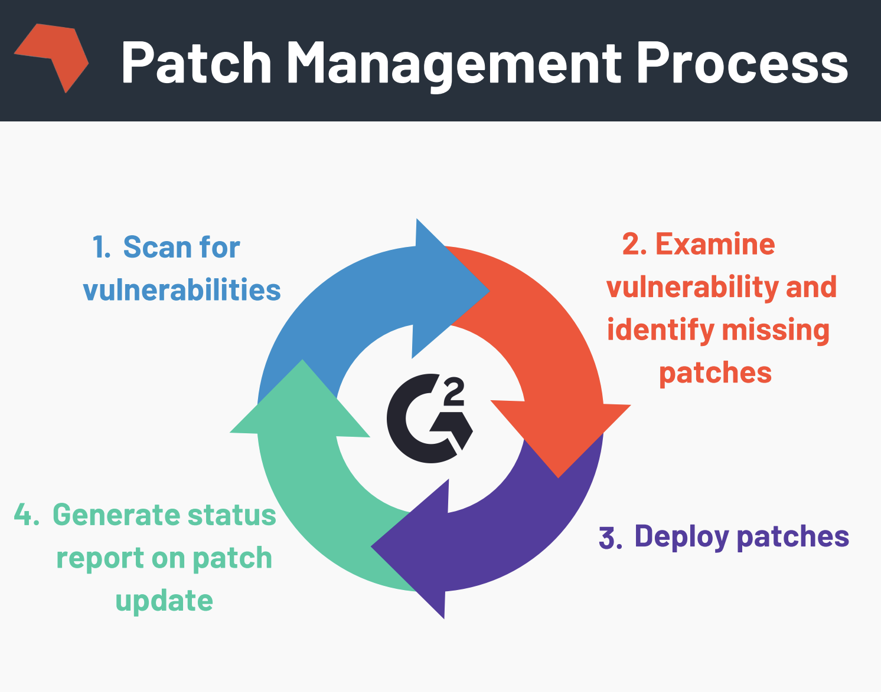
Best Practices for VPN Management
Implement regular updates and patches for VPN software and associated configurations.
Conduct periodic security reviews and penetration testing to identify vulnerabilities.
Educate users on security best practices to minimize risks associated with remote access.
9
Notes:
Image source: https://learn.g2.com/patch-management

Slide 11
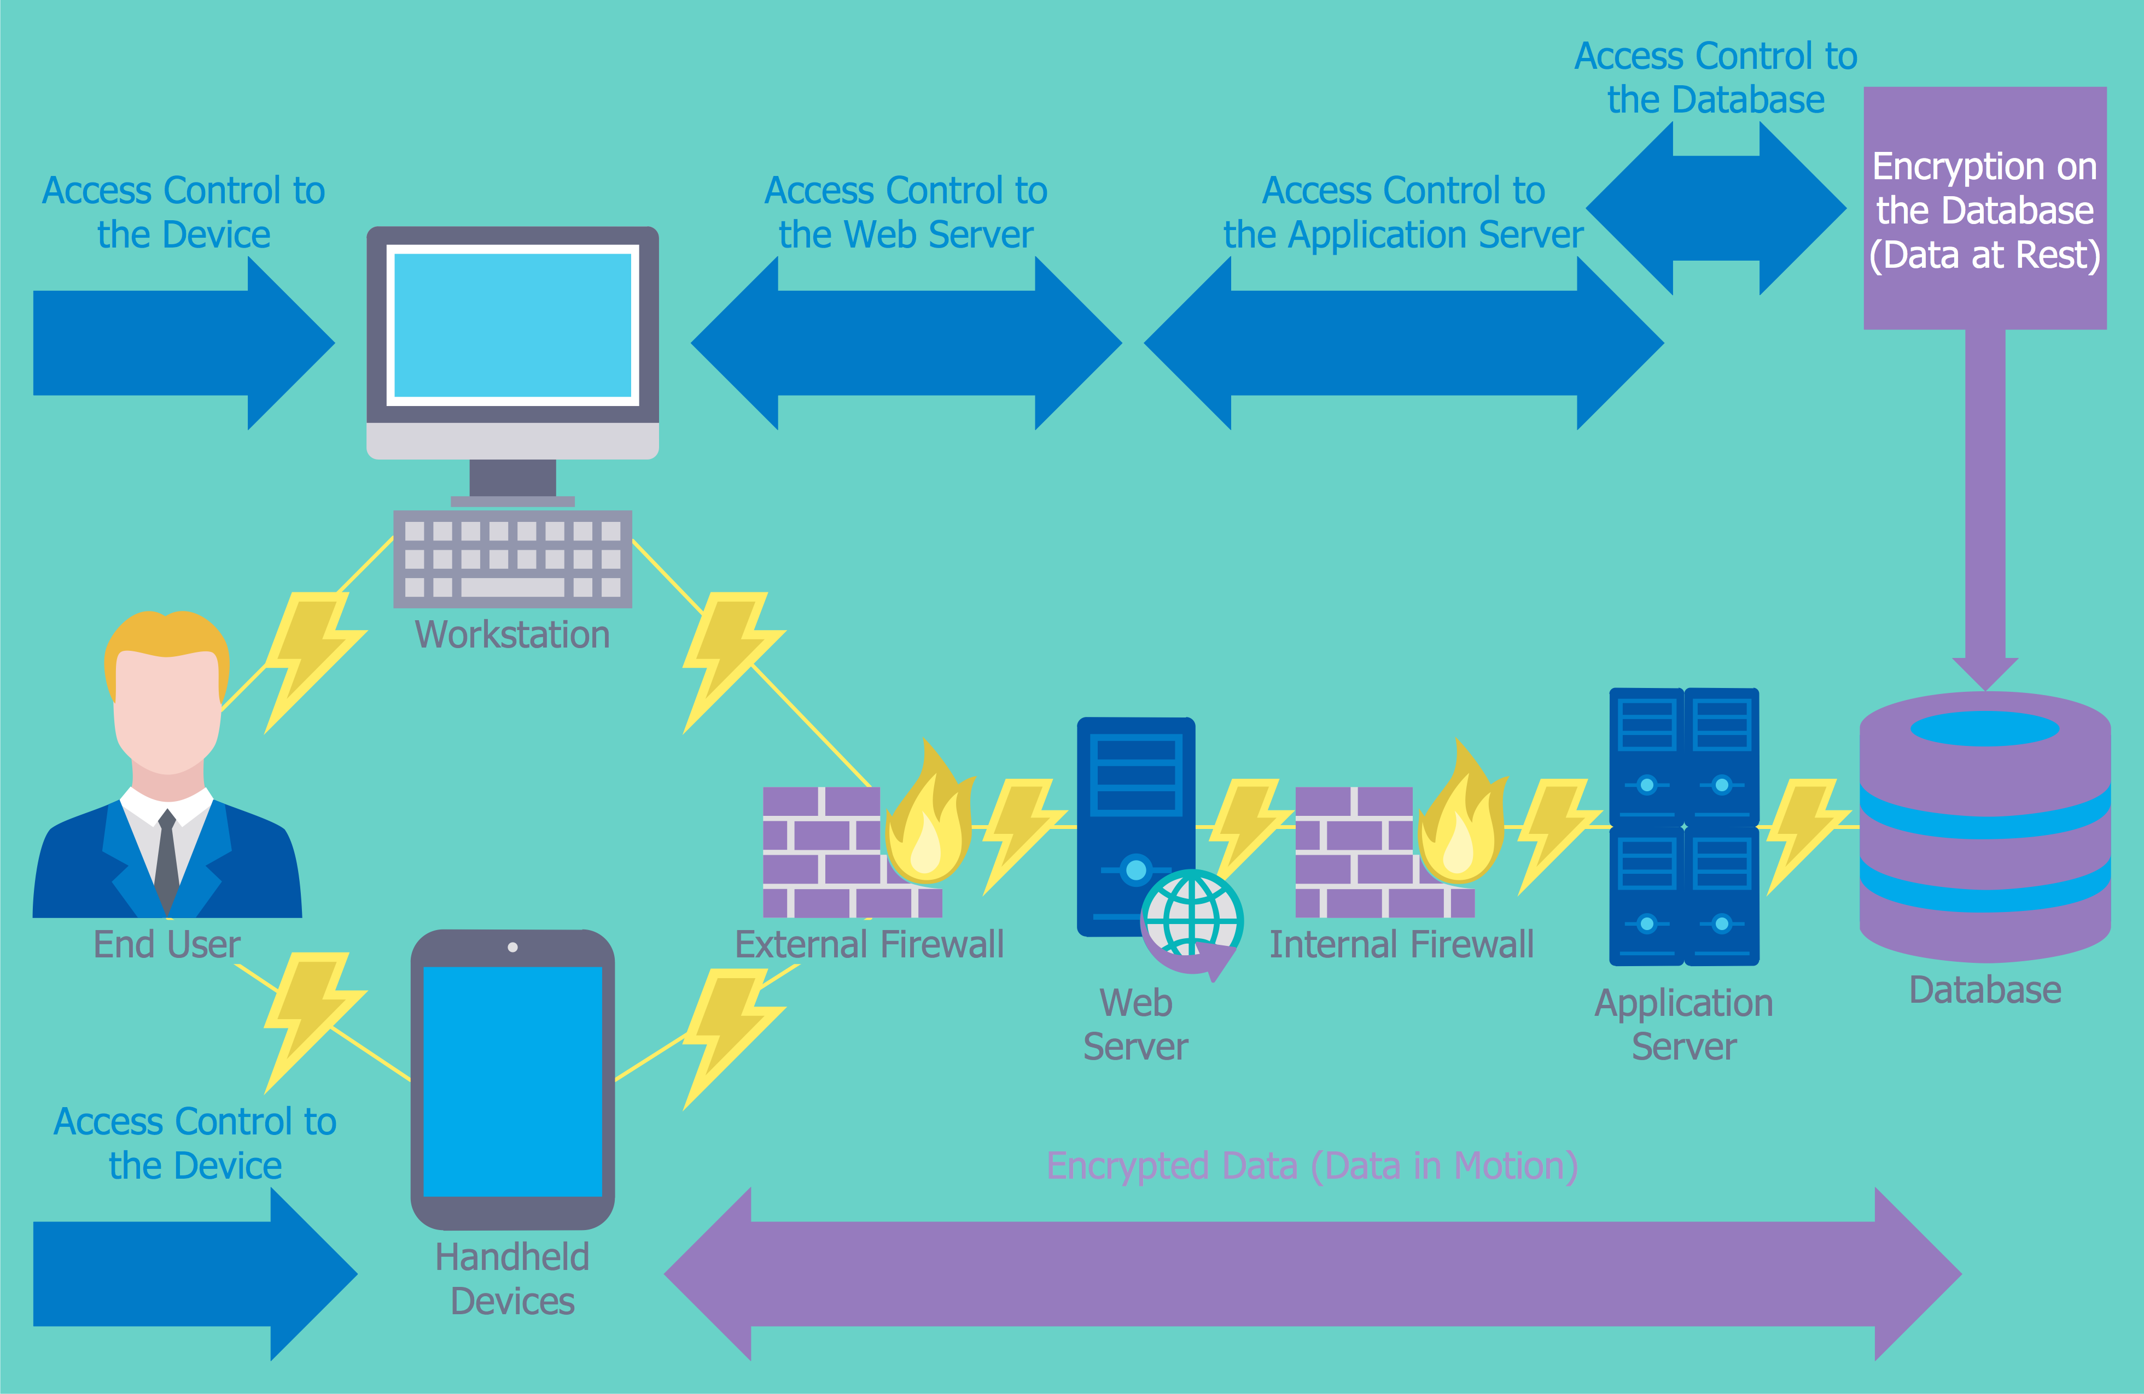
Conclusion and Next Steps
A secure VPN solution is critical for protecting data in a distributed workforce environment.
Following best practices in design, configuration, and management enhances overall security.
Organizations should continuously evaluate and improve their VPN solutions to adapt to evolving threats.
10
Notes:
Image source: https://www.conceptdraw.com/How-To-Guide/it-security-solutions

Slide 12



